Slide 1

TQS final presentation Group 45
Andreia Portela 97953
Tiago Matos 98134
Vítor Dias 98396
Ricardo Ferreira 98411
23.06.2022
Notes:
Ricardo

Slide 2
Part 1: Implemented products and services
Notes:
Ricardo

Slide 3
CityDelivery platform: key features
Accept deliveries and returns an order ID (later used to track the order)
Check deliveries list
Deliveries statistics
Notes:
Ricardo

Slide 4
PoC integration: aDress business
Sign/Log In
Make purchases
Track orders
Notes:
Andreia

Slide 5
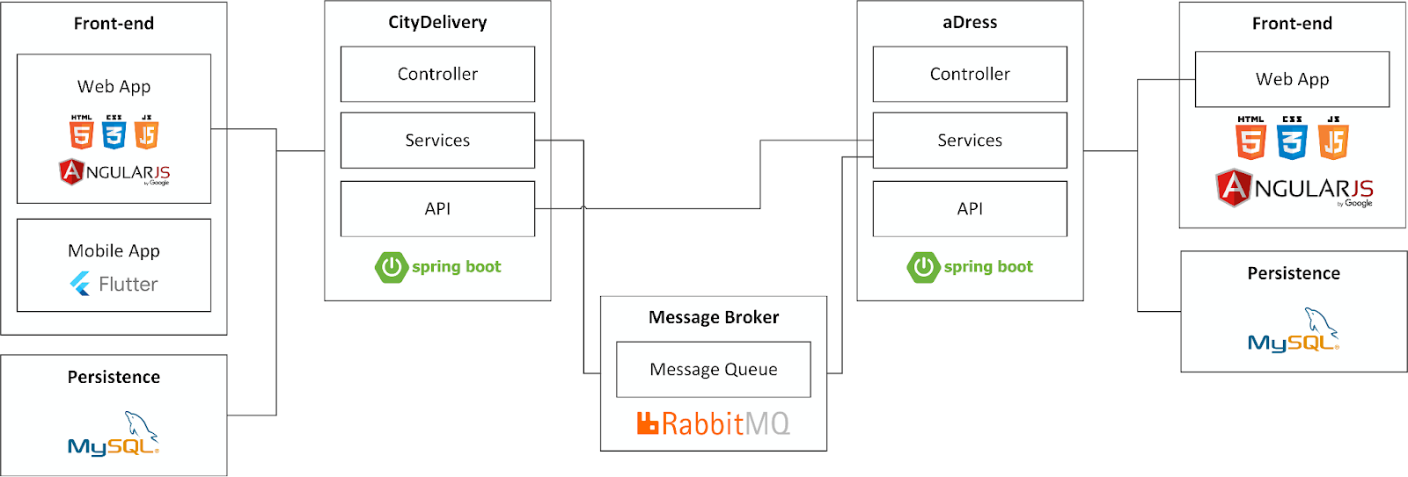
System overview
Notes:
Tiago

Slide 6
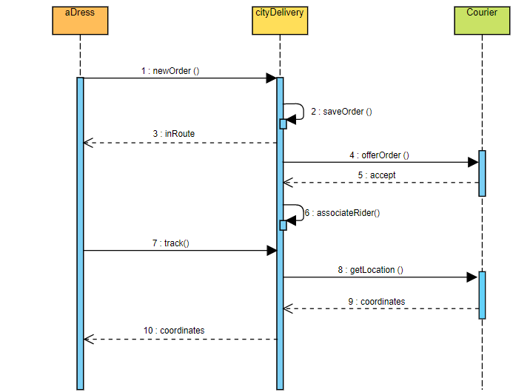
System flows and B2B integration
Notes:
Tiago

Slide 7
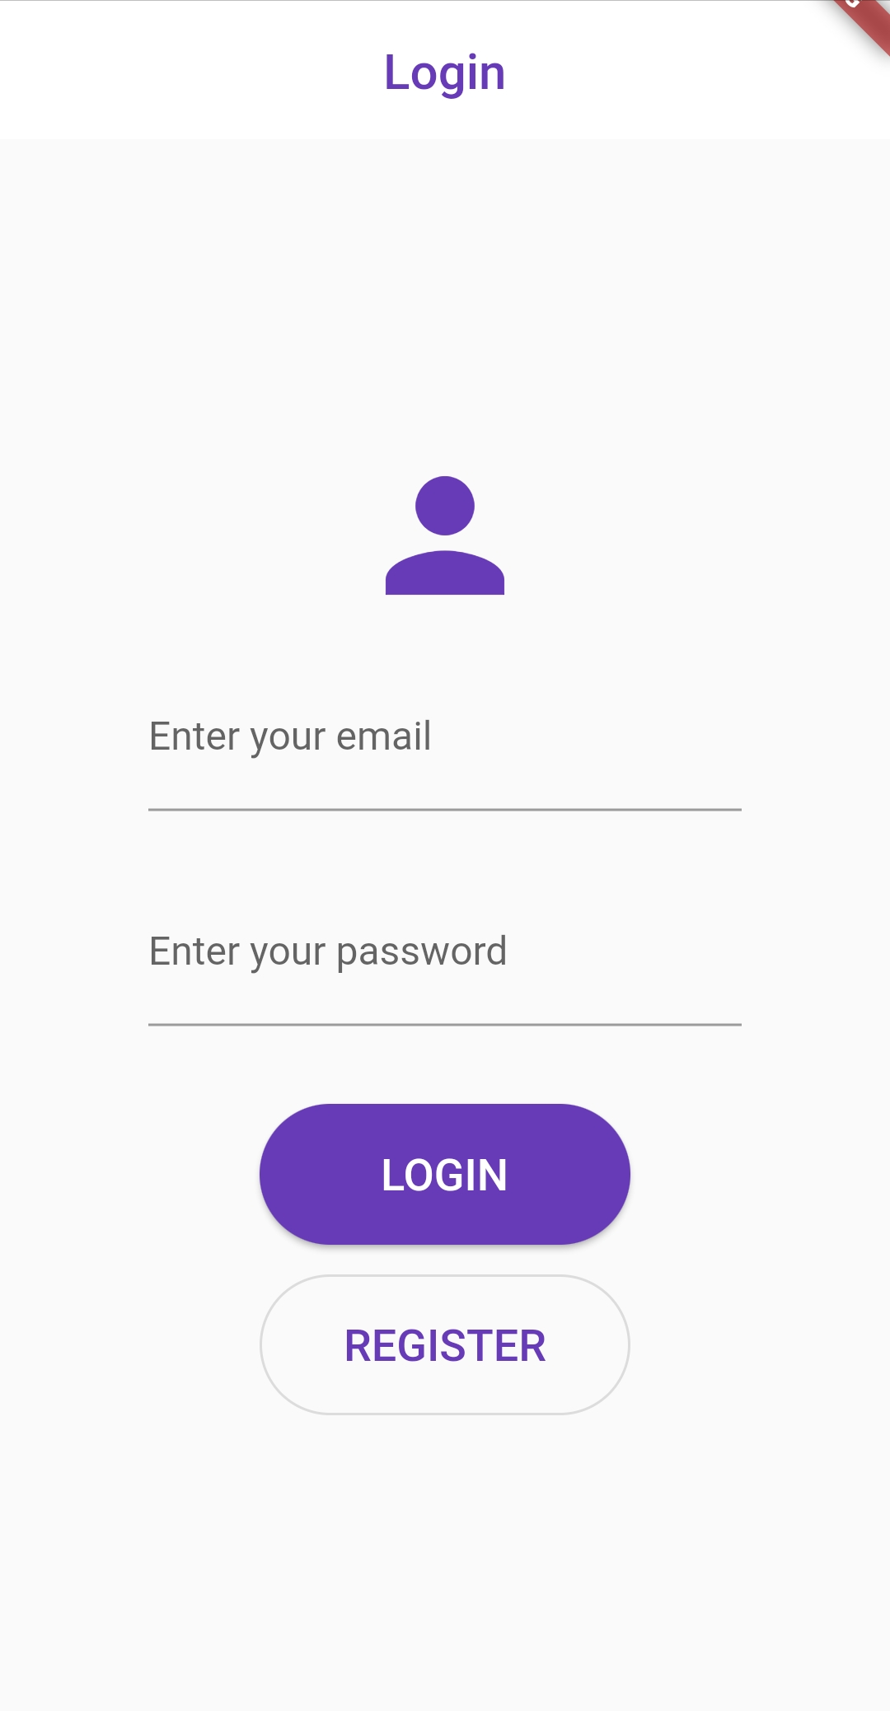
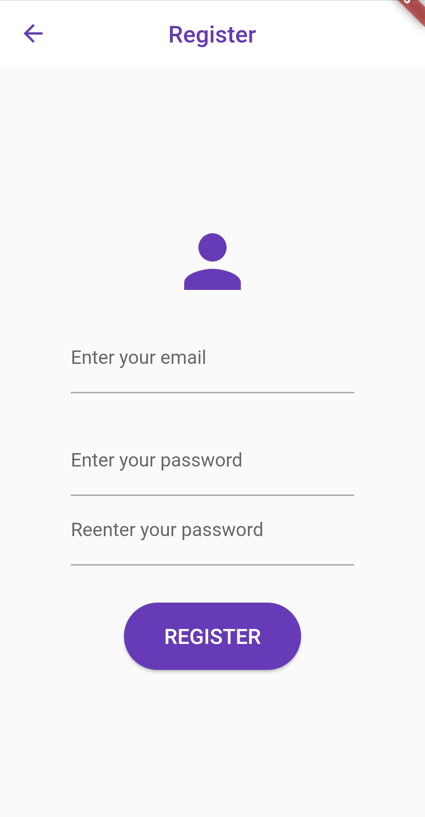
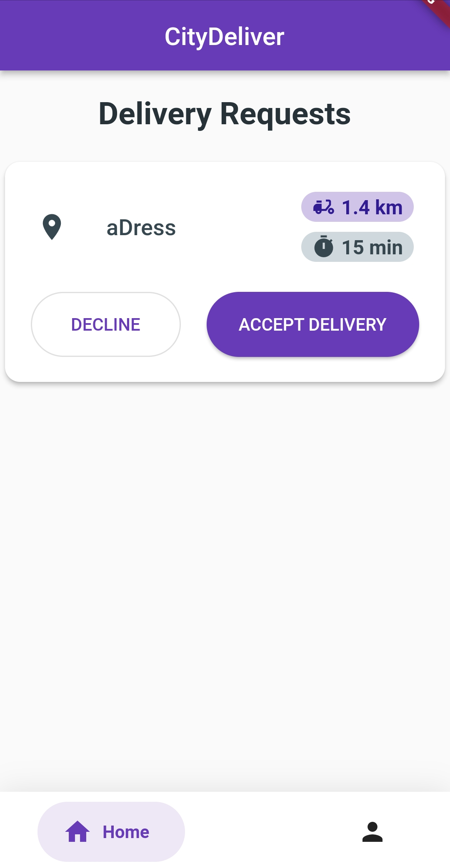
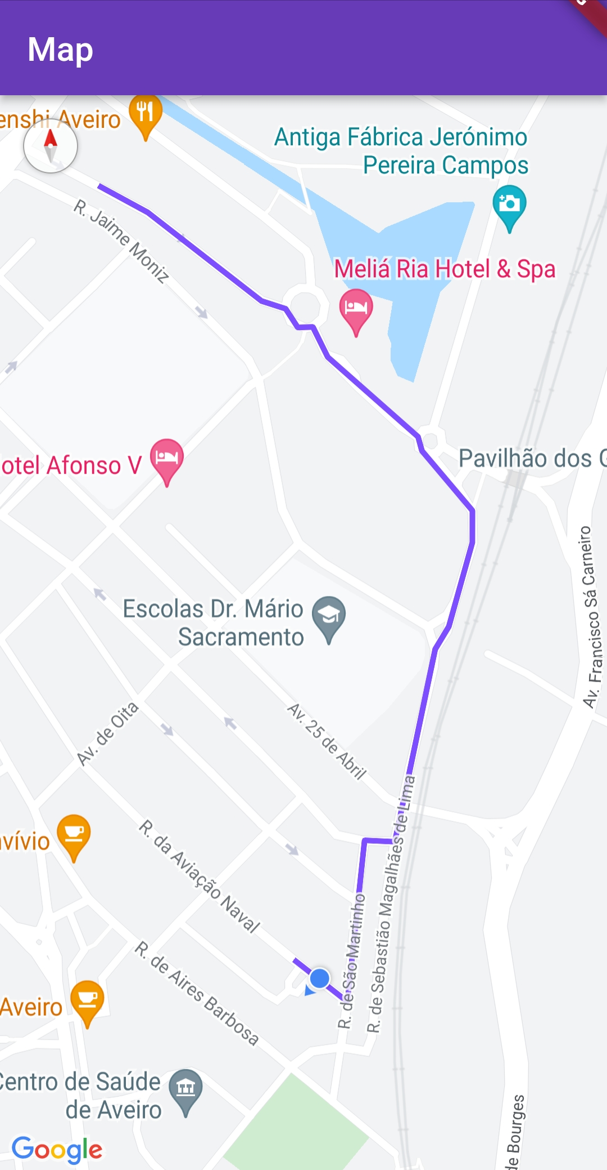
Products demonstration
Notes:
Tiago

Slide 8
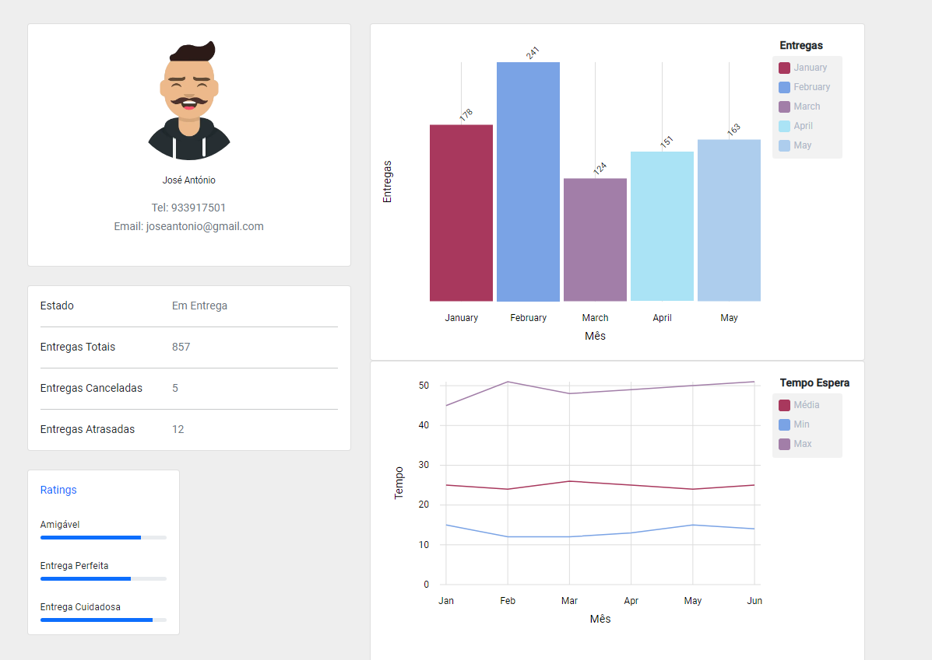
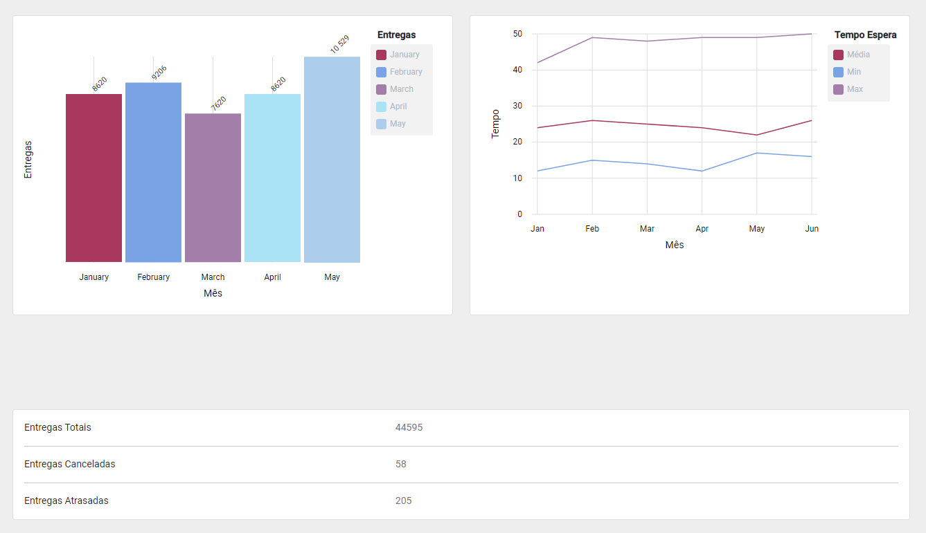
Products demonstration
Notes:
Ricardo

Slide 9
Products demonstration
Notes:
Andreia

Slide 10
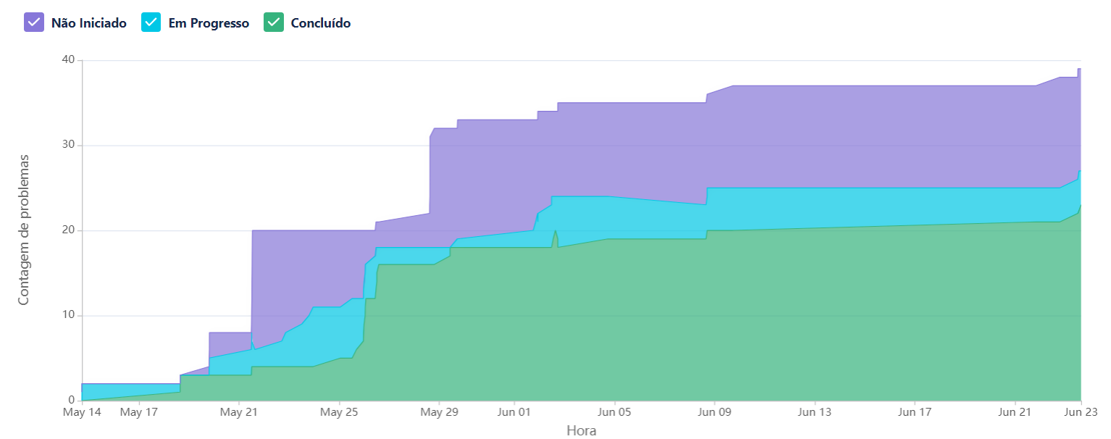
Current limitations
Development of the mobile app
Statistics in cityDelivery are static
Time
Notes:
Vitor

Slide 11
Part 2: Development workflow
Notes:
Andreia

Slide 12
How did we work?
Agile project management and work assignment
The work was divided into 4 Epics. Each had multiple issues corresponding to use cases and the team leader assigned each a number of story points (indicating how important the issue was).
Cooperative development and integration of new increments
We worked with pull requests that could only be accepted if the code was up to the stipulated metrics (Sonar and code metrics) and peer-reviewed.
Side | Epic
CityDelivery | Deliver Product
 | Management System
ADress | Store Navigation
 | Make Purchase
Notes:
Andreia

Slide 13
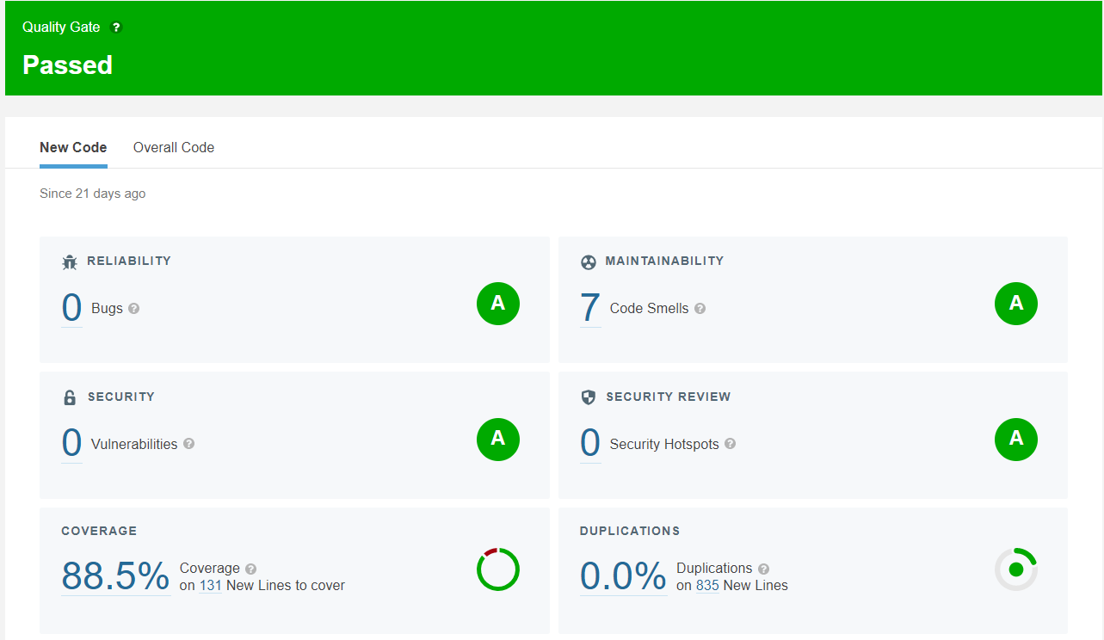
How did we work?
Test Driven Development
Write tests first and then implement functionalities to pass the tests. At the end, refactor the code.
Testing
Unit tests
Integration tests
Functional tests (with Selenium and Cucumber)
Notes:
Andreia

Slide 14




How did we work?
CI/CD strategy
The continuous integration was made with a WorkFlow in GitHub actions using a SonarCloud bot. The code would be analyzed every with PR into the main branch.
The continuous delivery was made in a Virtual Machine with 4 containers (2 for the databases, 2 for the servers). The code pushed to the GitHub main branch is directly sent to the VM, assuring the VM is always up to date with the latest version of the software.
Notes:
Vitor

Slide 15
Highlights on the implemented SQA strategy
Strong points:
Everyone is aware of the code written
Shared responsibility
No bugs found after delivery
Weak points:
Time spent waiting for a peer-review
Notes:
Vitor

